Slide 1
Info 4100 Introduction to Information science

Slide 2
What is “Information Science”?
Module 1

Slide 3

Information
“Information” can be viewed from different perspectives:
1st dimension: it is concerned with computing, algorithms, data science;
2nd dimension: It is concerned with “information and communication technologies”;
3rd dimension: Information is an entity with physical and biological science;
4th dimension: Information is concerned with information recorded in documents, with meaning and knowledge, which originated from a traditional discipline of librarianship and documentation.

Slide 4
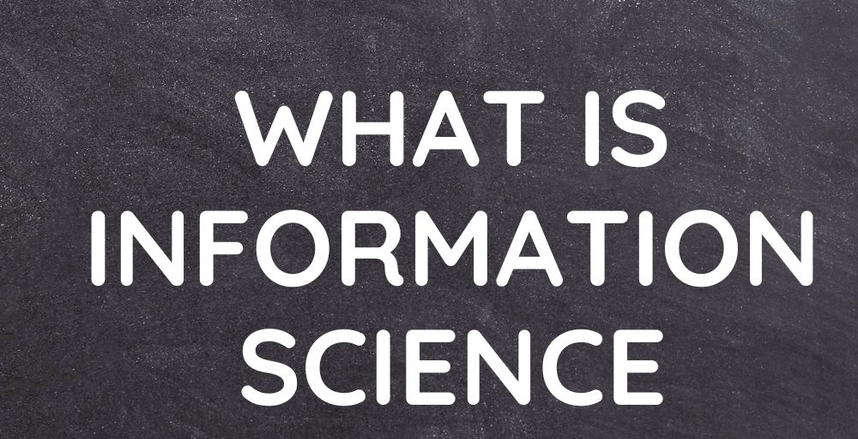
Information Science
Information science (one definition):
Information science is the science and practice dealing with the effective collection, storage, retrieval and use of information. It is concerned with recordable information and knowledge, and the technologies and related services that facilitate their management and use.
The Nature of Information Science:
IS is a field of study which has the “multidisciplinary”, “interdisciplinary” nature;
IS focuses on the “communication chain of recorded information”;
IS is a vocational discipline and involves many professional practices:
Data, information, knowledge management;
Metadata and taxonomy;
Record management and archiving etc.

Slide 5

Library & Information Science (LIS)
Interdisciplinary domain concerned with:
creation, organization, management, use, archival and disposal of information in all forms—communication chain/cycle of information
Information
Technology
People
Make Information Accessible and Usable
WE B I N S T I T U T E O F UT A H

Slide 6
History of Information Science
Module 2

Slide 7
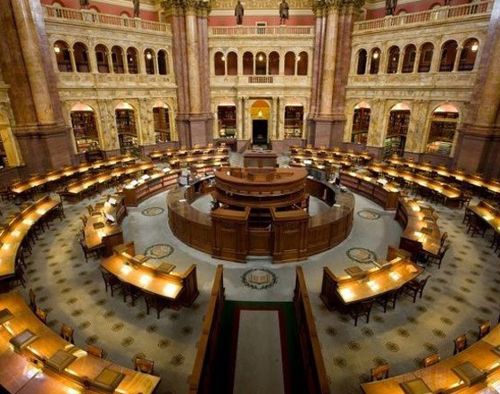
Early History
Philosophies of Enlightenment
“Library and information” was viewed as important to the new democracy by Thomas Jefferson and other funders
Foundation was built in 19th century
Library of Congress (LC) was established in 1800;
Government Printing Office printed 41 million copies of their publications by 1894;
Local community created 2,240 public libraries between 1850-1875;
American Library Association (ALA) was formed in 1850.
WE B I N S T I T U T E O F UT A H

Slide 8
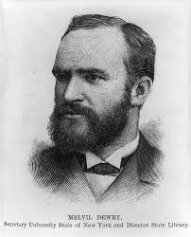


Emergence of “Library Science”
In 1887, first academic program—School of Library Economy at Columbia University – Mevil Dewey
In 1926, Carnegie Corporation provided funding to create The Graduate Library School (GLS) at the University of Chicago
The first program offer doctoral degree
Begin to develop deeper theoretical foundations and more substantive research
Researchers adopted and applied social and behavioral sciences to the examination of libraries
WE B I N S T I T U T E O F UT A H

Slide 9
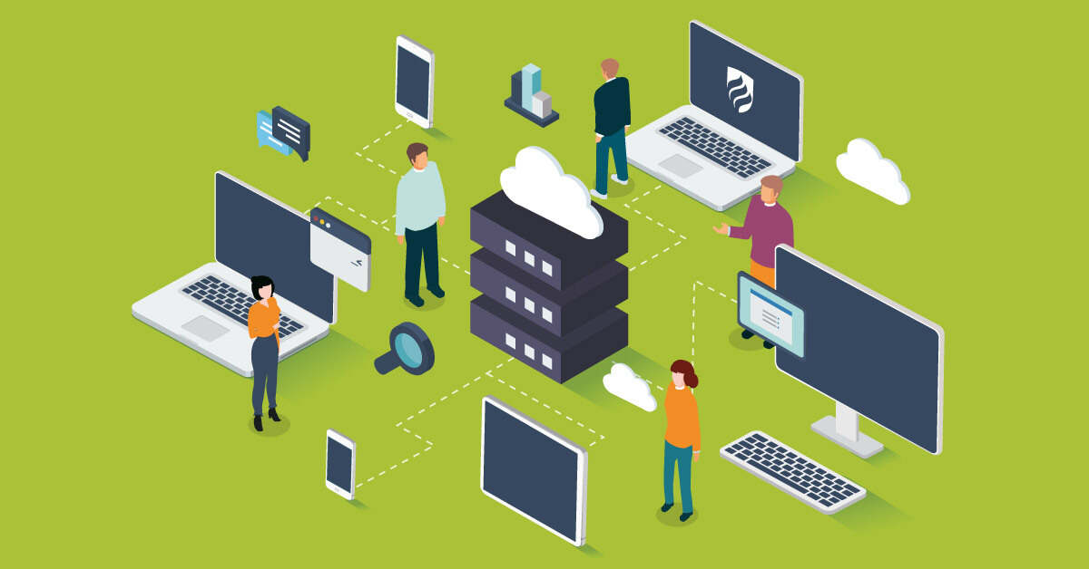
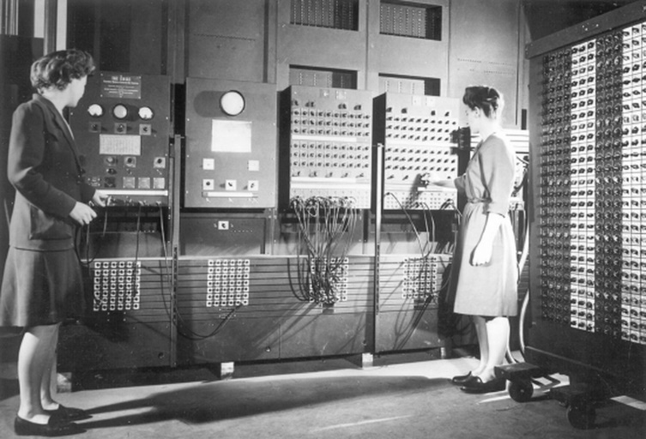
Information Science
Information Science is concerned with information itself and its representation:
What is information?
How should information be represented? (abstracting, indexing, categorization, summarization, and extraction)
How can we design systems to organize, classify, and retrieve information?
How can we optimize the accessibility and usability of information?

Slide 10
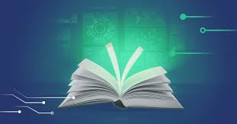
Convergence of LIS
LIS theory and research coalesced over the last 40 years of the 21th century
1960s, Federal funding for doctoral studies in LIS and for research in LIS increased dramatically
1980s/1990s – growth of systems, Internet
2005: “i-school caucus” was formed. I-field is an academic area of study and professional preparation in the intersection of technology, information, and people.
What is i-school?

Slide 11
Basic Concepts of Information Science
Module 3

Slide 12
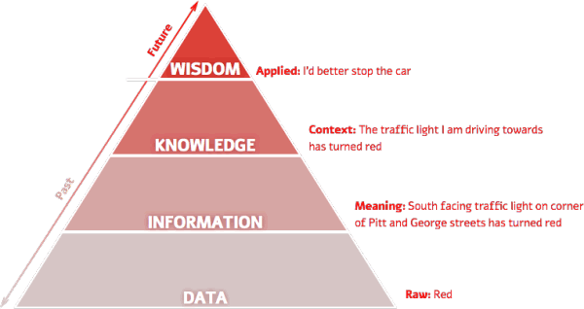
Data, Information, Knowledge, Wisdom (DIKW)
Fundamental to Understanding our Field
Data: Raw facts and symbols
Information: Data with meaning added.
Knowledge: Ability to understand info outside of original context.
Wisdom: Applying knowledge.

Slide 13

What is a Document?
Document: A record that stores and communicates data and/or information.
Could be printed or digital.
Why do we need documents?
Provides a reference for information.
Content: Can contain structured or unstructured data or information.
Examples: Books, articles, movies, datasets, emails.
Are texts documents?
Are elephants documents?

Slide 14

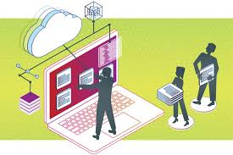
What is a Library?
Libraries are repositories for documents.
Libraries do not just store documents, but also organize them logically to support finding.
Libraries can be physical (e.g., a public library, your personal library) or digital (databases of resources).
Libraries of various types have existed since the beginning of civilization.

Slide 15
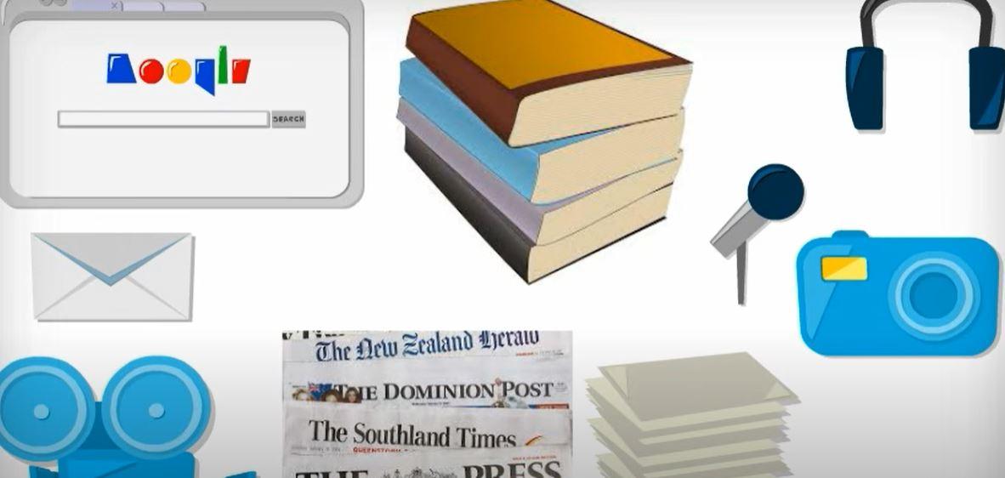
How Do We Interact with Information?
Creation of information: We create information when we interact with our world, communicate with people, and record things.
Organization of information: We arrange and label information to support our ability to find it later.
Retrieval of information: We look for and retrieve information to suit our needs.
Use of information: We use information for a variety of purposes.
Preservation of information: We back up and archive information for long-term use.

Slide 16
Information Organization
Module 4

Slide 17
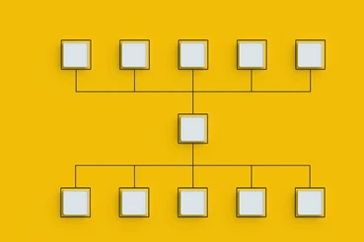
What is Information Organization?
The methods and systems used to structure, categorize, and management information for efficient access and use.
We use information organization to support the storage and retrieval of documents, including information resources like books and collections of data (data sets).
Necessary to support information retrieval (easily sort through millions of documents to find the one or few that you need).
Requires a detailed organizational structure with unique identifiers for each document.

Slide 18
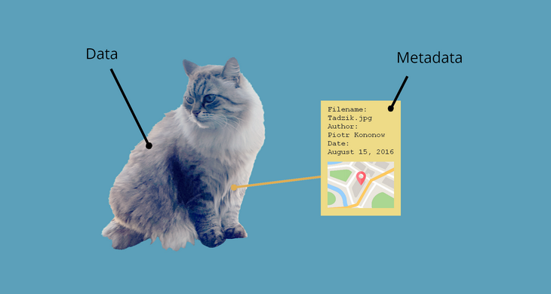
Metadata
Literally “data about data” – data describing attributes of documents to support organization.
Several different types:
Descriptive: Information about the content of the document: title, author, keywords.
Structural: Aspects of the form of the document: file formats, edition.
Administrative: Technical details about the document’s storage: creator of record, creation date.

Slide 19
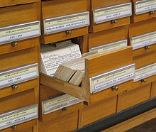
Cataloging
Cataloging is the process of creating records to support the retrieval of documents.
The process of creating and entering metadata that describes the documents.
Follows standardized formats that indicate what data should be entered and what format it should take.
Professional catalogers work with documents and systems in creating and entering metadata.

Slide 20
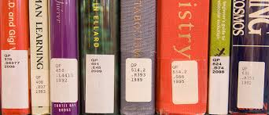
Classification Schemes
Classification schemes are used to support the finding of physical resources in a collection.
A call number is assigned to the resource, with an identifier on the resource that is also associated with the digital record.
Many different types of classification schemes!

Slide 21
Information Retrieval
Module 5

Slide 22
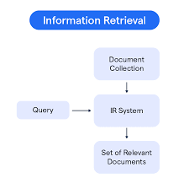
What is Information Retrieval?
Information Retrieval is the process of obtaining relevant documents/information from a large collection of resources.
Basic elements of information retrieval:
A collection of documents.
A system that stores and organizes the documents.
An interface through which people interact with the system.
A person, who develops a need for information, and then produces a query to search for relevant documents.

Slide 23
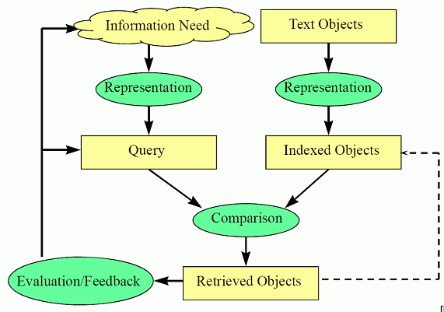
Models of Information Retrieval
Models allow us to visualize common patterns of behavior and predict how people will interact with our systems.
Researchers observe the behavior of users as they interact with a system and ask questions about what the users are thinking as they are doing.
This information supports the design of improved systems.

Slide 24
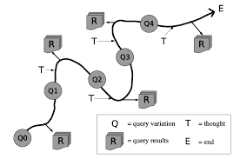
Models of Information Retrieval (Continued)
Models can vary significantly based on the task involved, the users studied, and the type of system being used.
We may come to develop new insights about the same behaviors using a different mental frame.
For instance, the Berrypicking model (right) shows a more naturalistic approach to how users find information in the modern age.

Slide 25
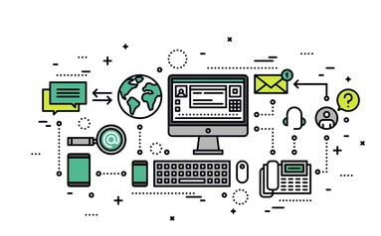
Implications of Retrieval for System Design
An understanding of information retrieval patterns guides the design of new indexes and data ranking.
Google PageRank
We want to design the best systems to support user behavior in order to increase adoption/use.
We can better ensure that users find relevant resources.

Slide 26
Information Behavior
Module 6

Slide 27

What is Information Behavior?
Information behavior refers to how people interact with information in their environment (or literally “how people behave with information”).
There are many different behaviors that we can observe: information seeking, information sharing, information use (more on next slide).
Information behavior is highly contextualized: the type of person, the type of setting, and the type of information needed can significantly affect the behaviors that occur.

Slide 28

Concepts of Information Behavior
Information Need: The need for some specific information.
Information Seeking: The process of actively searching for the needed information (may include retrieval activities).
Information Sharing: Exchanging information with others.
Information Use: Applying the information to solve problems or make decisions.
Information Poverty: A state where one is unable to find any information that addresses their needs.

Slide 29
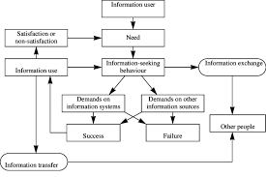
Models of Information Behavior
Wilson’s (1981) model (left) is one of the most widely-known.
Sense-making (Dervin) – how people make sense of gaps in the information they need, including emotional responses.
Ecological Model – how peoples’ environments influence how they interact with information.

Slide 30
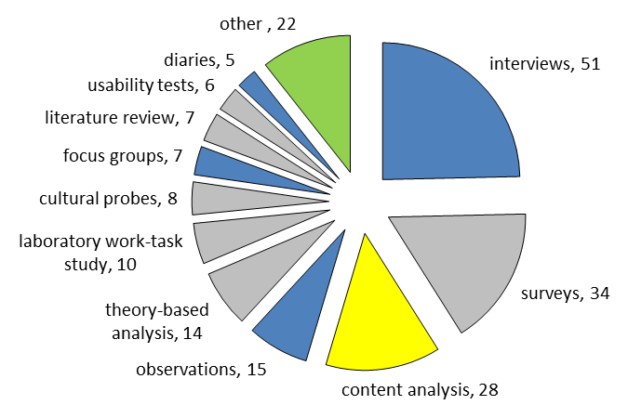
Why Should We Study Information Behavior?
Tells us about how people interact with information and technology, which is useful for designing new systems and tools.
Understanding human psychology in the interaction with documents and information.
We primarily study information behavior through the use of surveys and interviews. This is fundamentally human research.
2012-2014

Slide 31
Informatics
Module 7

Slide 32

What is Informatics?
Informatics is the application of information and data technologies to solve problems across various domains.
Requires a combination of knowledge from both natural sciences (how technology works) as well as social sciences (how people and society work).
Answers questions like:
How do people interact with new technologies?
Will artificial intelligence be embraced by the public?
How can we improve health outcomes for patients based on health data?

Slide 33

Brief History of Informatics
In the 1950s and 1960s, the emergence of new computing technologies brought questions of the implications of these innovations on people and society.
In the 1970s and 1980s, context-specific information systems matured, allowing for a variety of applications. This resulted in new areas of informatics – health informatics, business informatics.
1990s brought innovations in personal computers and the Internet. Soon mobile phones, AR/VR, and AI would further transform the technological world around us.

Slide 34

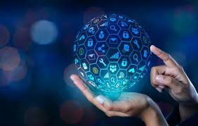
Types of Informatics
Health Informatics: Using information and data technologies to improve healthcare delivery and outcomes.
Bioinformatics: Using biological data to advance research in genomics and medicine.
Social Informatics: Investigating how society impacts and is impacted by the emergence of new information and data technologies.
Educational Informatics (Learning Technology): Using information and data technologies to improve teaching, learning, and educational administration.
Business Informatics (Info Systems): Using information and data technologies to improve business performance.

Slide 35

Impact of Informatics
Informatics is a highly interdisciplinary field, meaning that it encourages collaborators from a wide variety of fields (e.g., computer science and sociology).
Research in informatics supports user-friendly and ethical design of new technologies based on our understanding of how people use these technologies.
Building a technology is great, but it only has value if people want to use it!

Slide 36
Information Management
Module 8

Slide 37
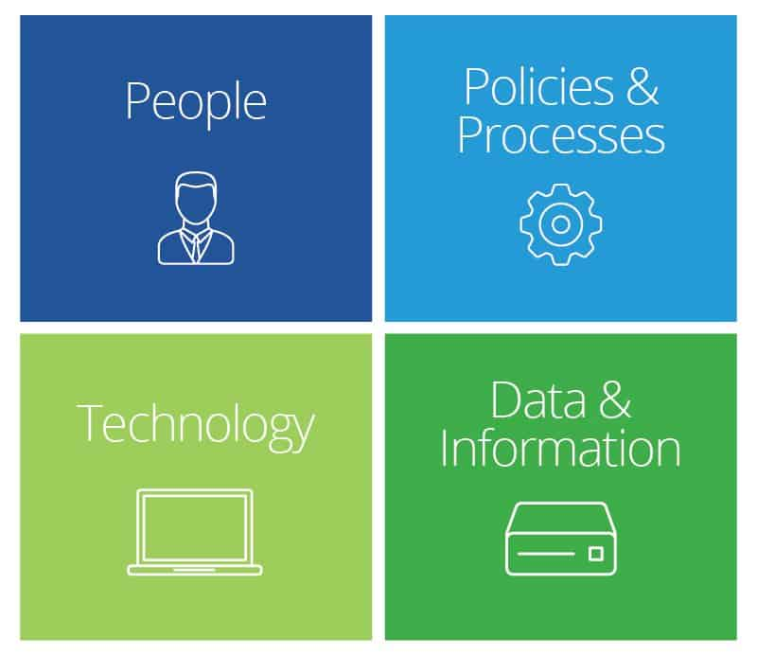
What is Information Management?
Ensuring that information is successfully organized and stored throughout its lifecycle within organizations.
Manage the seamless interactions between people/users, organizational technology, data, and information, and the policies and procedures that are in place.
Ensures quality and efficiency of data and information.
Requires the ability to work both with people and information tools like databases and content management systems.

Slide 38
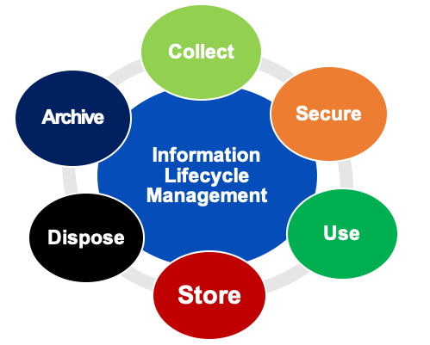
Lifecycle of Information
Model of how information is created, stored, use, and deleted within organizations:
Creation/Collection: Producing or gathering relevant information.
Secure/Organize: Structuring information for accessibility and protection.
Use: Applying information to achieve specific goals.
Store: Retaining information for future use.
Dispose/Deletion: Periodic removal of redundant or unnecessary information.
Archive: Retaining information that has long-term value.

Slide 39
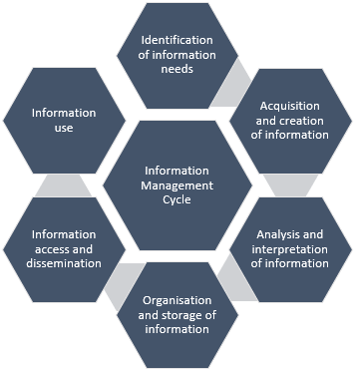
How Do We Manage Information
Information Governance: Creating policies and procedures to ensure information compliance with legal, regulatory, and ethical standards.
Content Management and Database Systems: Making organizational information accessible to those who wish to use it.
Data Analytics and Reporting: Creating insights from organizational data.
Training: Guiding others within an organization on how to manage their own information and share it within the organization in a responsible manner.

Slide 40
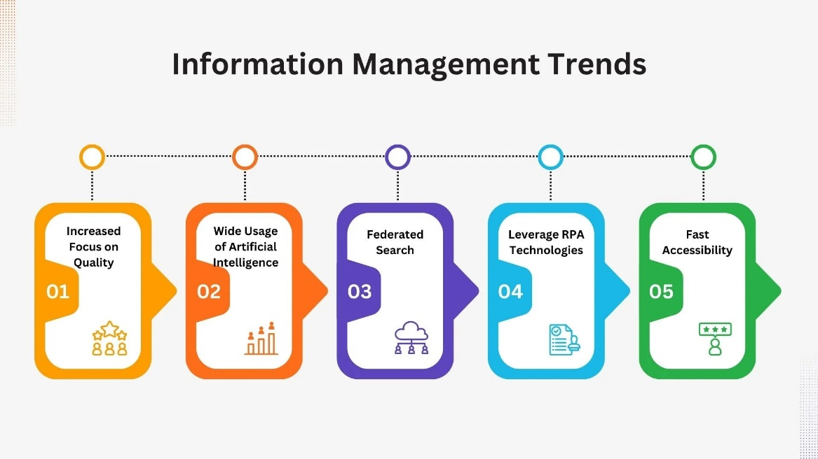
Future of Information Management
Considerations relating to organizations’ applications of artificial intelligence, machine learning, and blockchain technologies.
Exploring applications of expanded cloud-based information management, edge computing, and Internet of Things within organizations.
Monitoring new policies and procedures relating to data privacy and security.

Slide 41
Information Ethics
Module 9

Slide 42
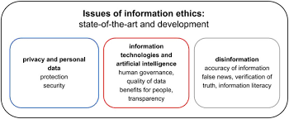
What are Information Ethics?
Information ethics are the ethical principles and issues related to the creation, dissemination, and use of information.
It is critical to not only handle information in an efficient manner but also an ethical one.
Information has power.

Slide 43
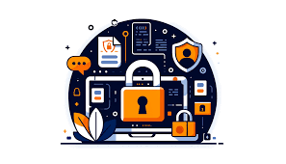
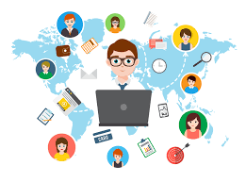
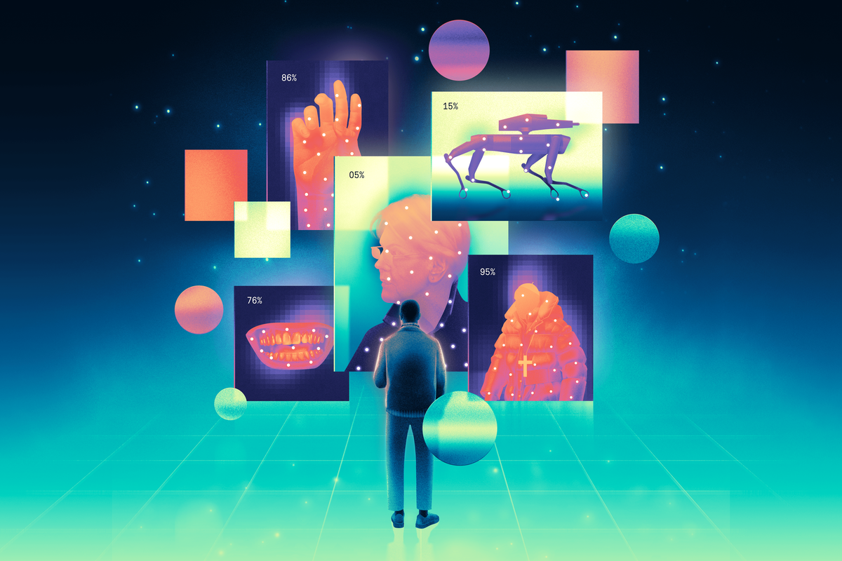
Ethical Principles for Information Science
Accessibility: Ensuring that information is accessible to all.
Accuracy: Ensuring the information is reliable and truthful.
Intellectual Property Rights: Ensuring that content creators retain rights while also ensuring that users have access to the info they need.
Privacy: Ensuring individuals’ rights to control their personal information.
Security: Ensuring that individuals’ information is not susceptible to breaches.
Transparency: Ensuring that individuals are aware of how their data and information is used by various technologies.

Slide 44
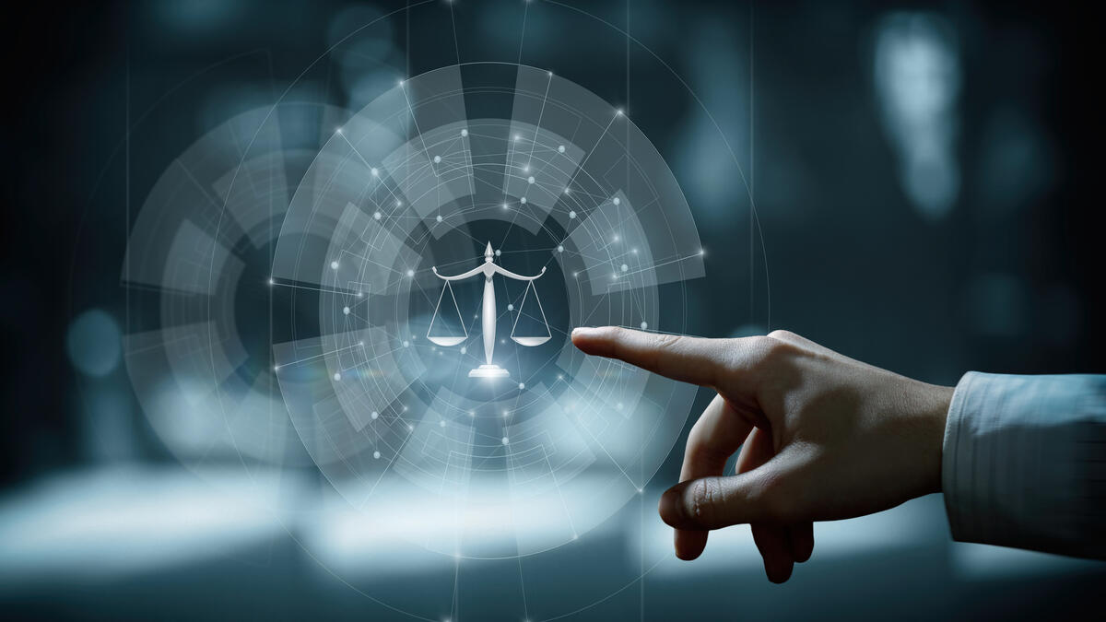
Why Do We Need Information Ethics?
Ethics are critical for building trust: People will be reluctant to adopt new technologies and share their data/information if they believe is will be misused.
Biases and breaches of privacy and security can put organizations at risk and harm the ability to make effective decisions.
To demonstrate our respect and value of the users of information and systems; to protect users as well as ourselves.

Slide 45

Reflecting on Information Ethics in Your Professional Career
Professional Accountability: You are responsible for upholding these ethics and values in your job.
Maintaining Trust and Credibility: These principles build and sustain trust with users and clients, necessary to ensure buy-in and use of your information and systems.
Upholding Organizational Policies: Understanding these principles gives a justification behind organizational policies – i.e., why we do things this way. This protects the employee and the organization.

